Slide 1
TOWER OF HANOI
CSE246
Faculty: Dr. Ashraf Uddin

Slide 2
Member
NAME | STUDENT ID
Kahirul Islam | 2020-1-60-109
Md.Abu Zafor | 2020-2-60-158
Zahidul Islam Turja | 2020-1-60-260

Slide 3
MOTIVATION
Visualize the algorithm of tower of hanoi
Easy to understand
Various uses

Slide 4
Road map of this project
First of all construct the algorithm
Using algorithm construct the code
Code has two part:
1. user interface portion
2. algorithms implement portion
Check with various input of this project
Using python language
construct the algorithm
construct the code
user interface portion
algorithms implement portion
Check with various input of this project

Slide 5
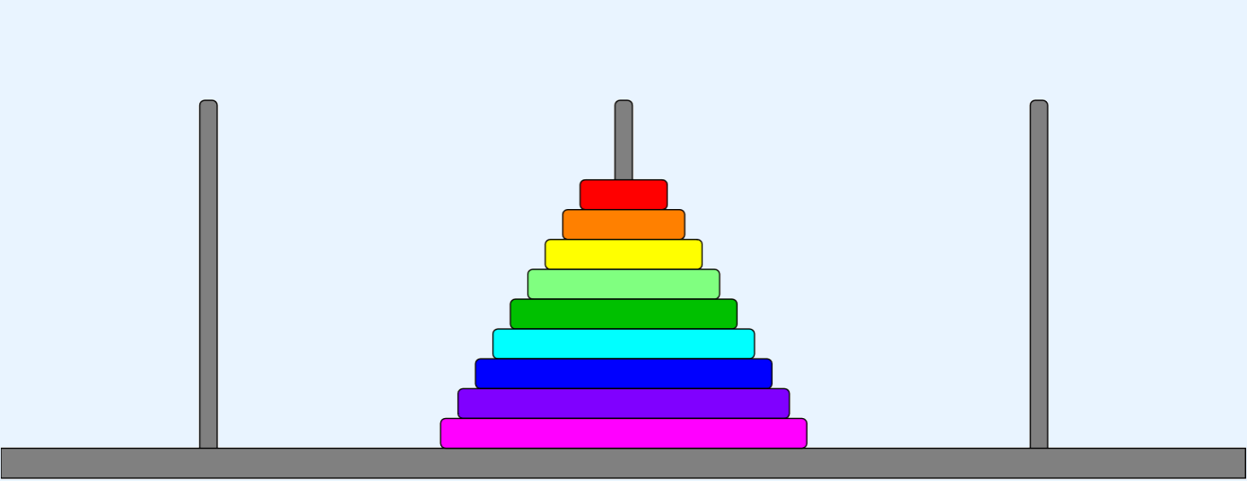
What is tower of Hanoi?
Tower of Hanoi is a mathematical puzzle where we have three rods (A, B, and C) and N disks
Initially, all the disks are stacked in decreasing value of diameter i.e., the smallest disk is placed on the top and they are on rod A
The objective of the Algorithm is to move the entire stack to another rod (here considered C) with smallest amount of moves.
A
B
C

Slide 6
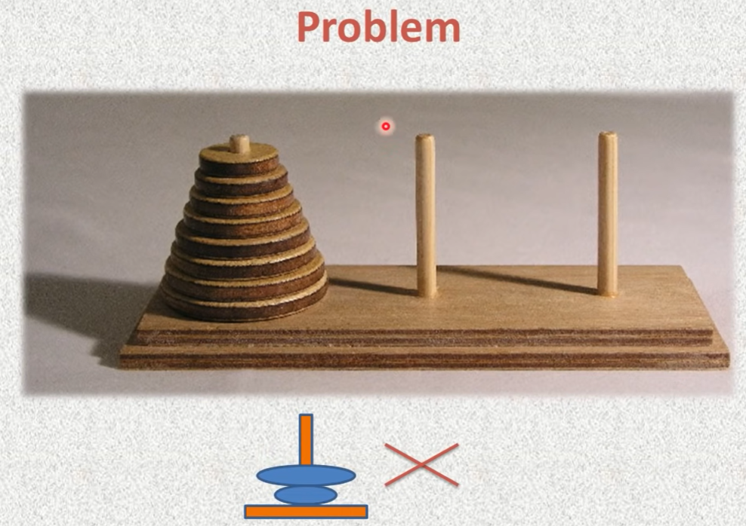

Slide 7
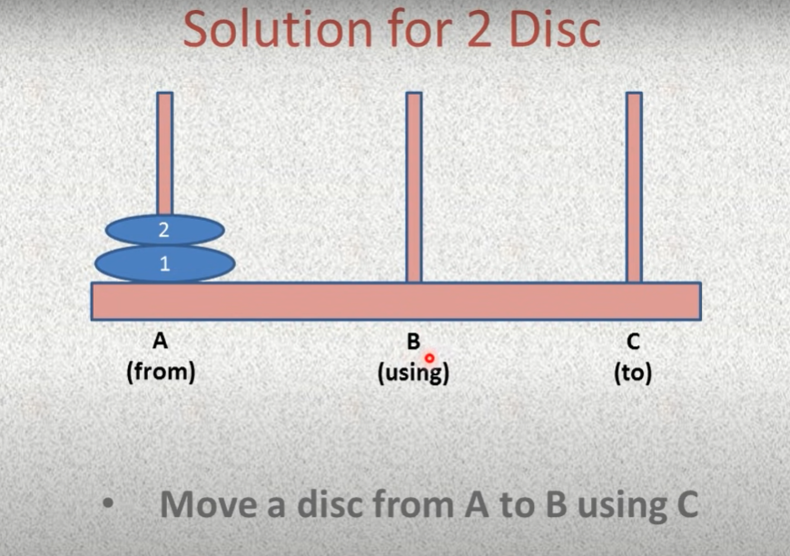

Slide 8
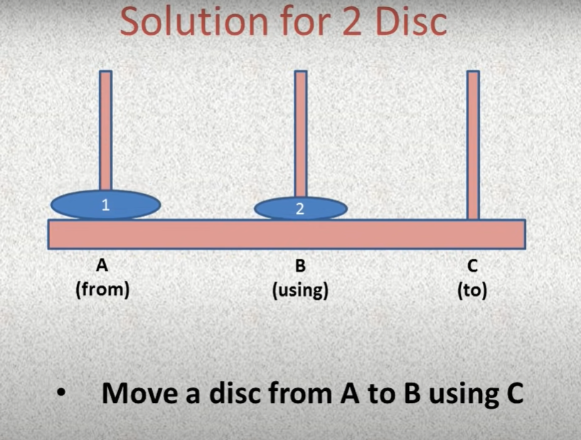

Slide 9
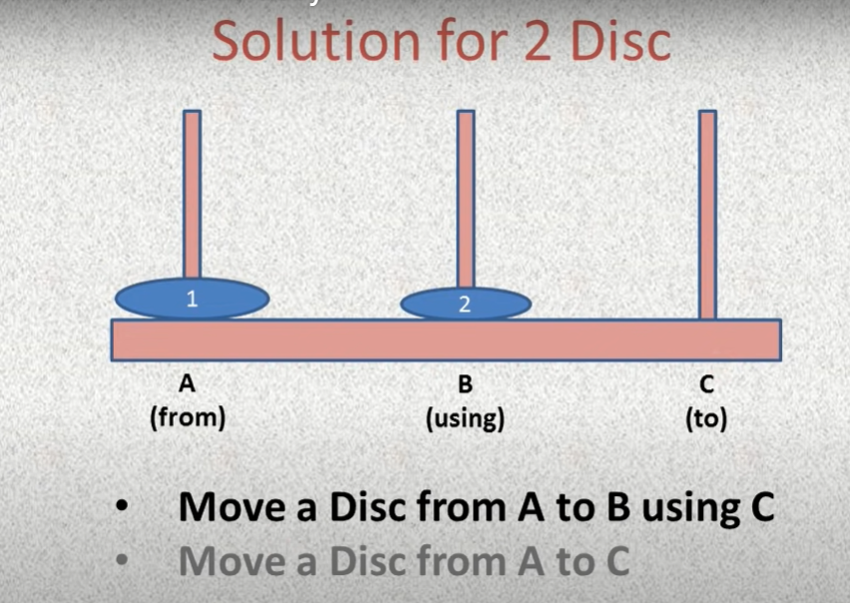

Slide 10
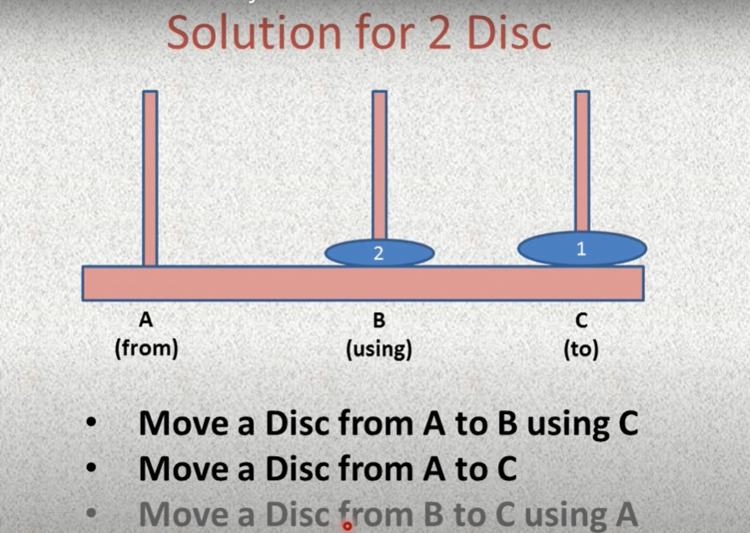

Slide 11
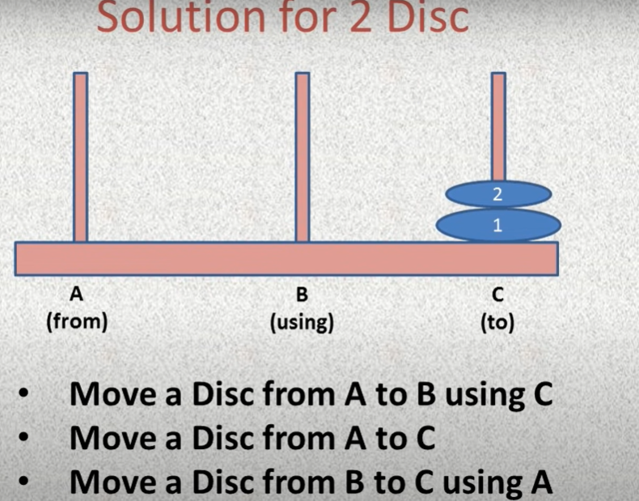

Slide 12
algorithm
INITILIZE THREE VAIRABLE
A, B, C which represent the rod of this puzzle
and N which represent the number of disc
Step1: check whether N = 1 or not
Step 2: if N = 1 call step 3 otherwise call step 4
Step 3: print move disc 1 From A to C
Step 4: Call function with N-1,A,C,B
Step 5: Print move disc n From A to C Using B
Step 6: Call function with N -1, B,A,C
A
B
C

Slide 13
algorithm
INITILIZE THREE VAIRABLE
A, B, C which represent the rod of this puzzle
and N which represent the number of disc
Void TOH( N,A,B,C)
if n > 0
TOH(N-1,A,C,B)
PRINT DISK MOVE FROM A TO C
TOH(N-1, B,A,C)
A
B
C

Slide 14
Flow chart
Start
Define a function name hanoi
Declare the n
Enter the number of discs
Call function hanoi
end

Slide 15
Flow chart
hanoi()
NO
n=1
YES
Print move disc 1 From A to C
Call function Hanoi with n-1,A,C,B
Print move disc n From A to C Using B
Call function Hanoi with n-1,B,A,C
Return

Slide 16
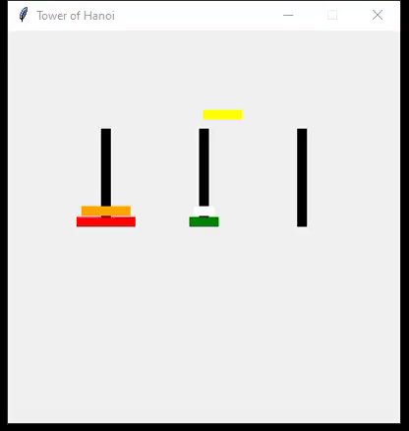
Simulation VIDEO of project

Slide 17
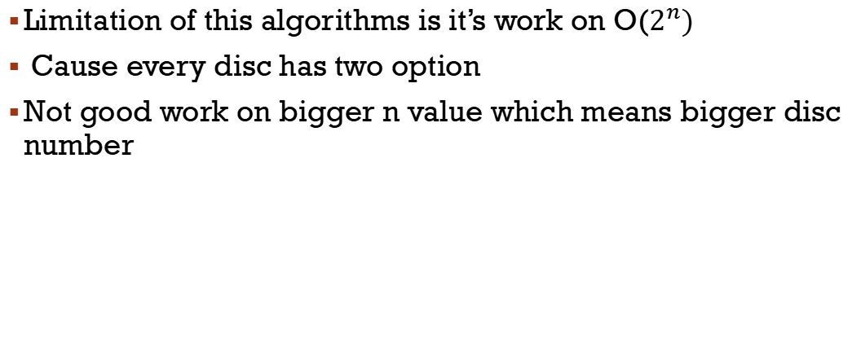
LIMITAION
Limitation of this algorithms is it’s work on O($2^{n})$
Cause every disc has two option
Not good work on bigger n value which means bigger disc number

Slide 18
Application
The Tower of Hanoi is frequently used in psychological research on problem-solving
The Tower of Hanoi is also used as a backup rotation scheme when performing computer data backups where multiple tapes/media are involved.
The Tower of Hanoi is also used as a test by neuropsychologists trying to evaluate frontal lobe deficits

Slide 19
Thank you

